Slide 1
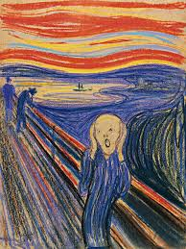
DESIGN PROJECT 2
PAINTING-SPATIAL INTERPRETATION-MODEL MAKING
AMAN SAIF
2025-ARCH-14
DEPT OF ARCHITECTURE

Slide 2
INTRODUCTION
Study the techniques of Edvard munch.
1
Reproduce the painting “the scream”.
2
Crate an expressionist painting of the university gate.
3
Develop section cuts of space inspired by painter.
4
Build a conceptual house model.
5

Slide 3
THE SCREAM ANALYSIS
Vibrant colors showing extreme emotion.
Wavy distorted lines creating tension.
Sky and landscape exaggerated to show anxiety.
Expressionism = emotion > realism

Slide 4
My reproduction of “the scream”
Used bold strokes and exaggerated curves.
Focused on emotion rather than accuracy.
Used high contrast colors.
Tried to capture the mood, not the same details.

Slide 5
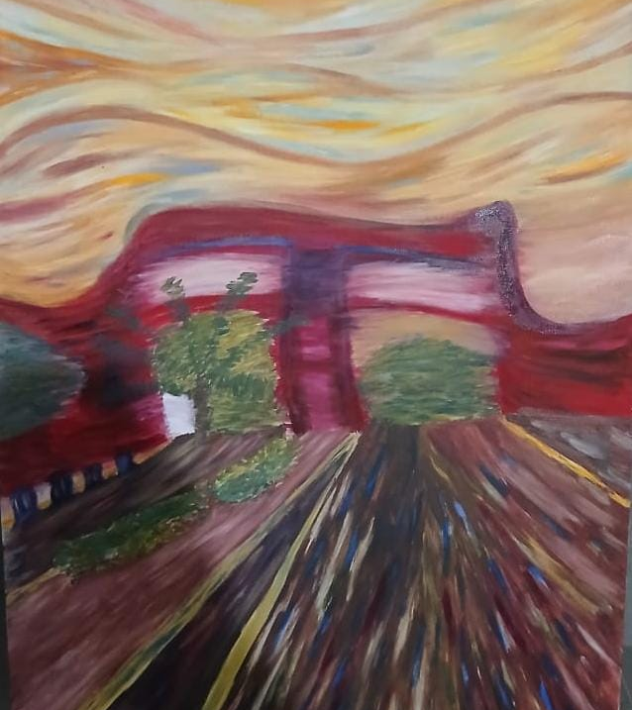
Expressionist painting of university gate
Using the techniques learned from munch, I created a new painting of university gate.
I focused on:
Exaggerated forms to make the structure feel alive
Dramatic sky and lighting to show mood
Strong contrasts to highlight depth and emotion
A distorted perspective to create expressionist impact
This helped me understand how everyday architecture can be transformed emotionally through expressive techniques.

Slide 6
Spatial interpretation for the painter
After studying Munch’s emotional themes, I translated his psychological world into spatial concepts.
Each space is based on a different emotional state:
Anxiety — chaotic, tight, heavy shadows
Memory — layered, textured, fading tones
Reflection — quiet, soft, minimal
Creation — open, bright, energized
Renewal — fresh, light-filled, calming
These emotional ideas guided the sections and architectural atmosphere.

Slide 7
Section cuts
Each section cut expresses a transition of emotions using shading. The foreground is dark, representing intense feelings, while the background gradually becomes lighter, showing emotional release and clarity.
Examples:
• Garden of Renewal — dark soil tones shifting to bright greenery
• Studio of Creation — strong shadows becoming energetic light
• Core of Memory — layered darkness fading into soft tones
Shore of Anxiety — sharp contrasts calming toward the horizon
• Room of Reflection — still, quiet gradients
This technique creates a visual emotional journey in every section.

